Slide 1
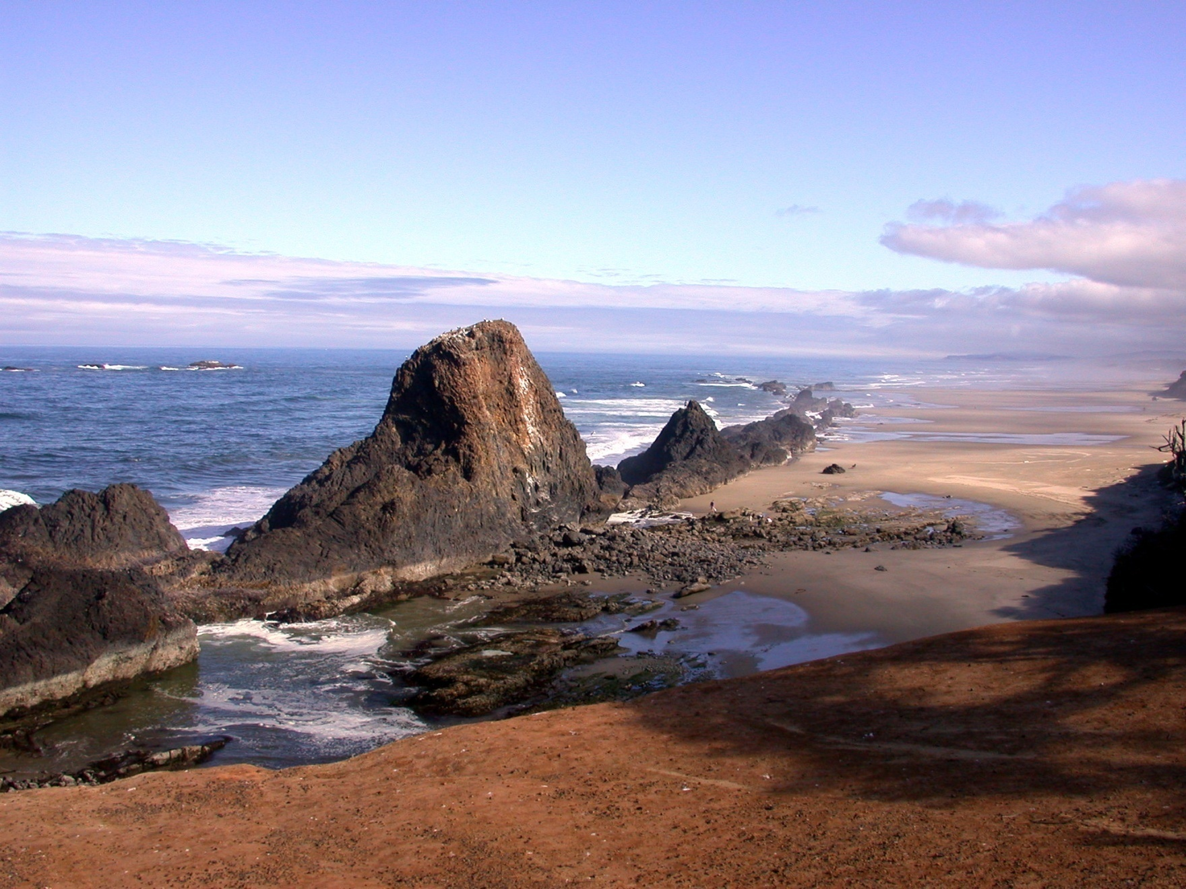
Oregon Coastal
Marine Life

Slide 2
Fundamental Differences
Primary producers
Invertebrate consumers
Factors affecting marine life

Slide 3
Land
Vascular plants
Mosses, lichens, etc.

Slide 4
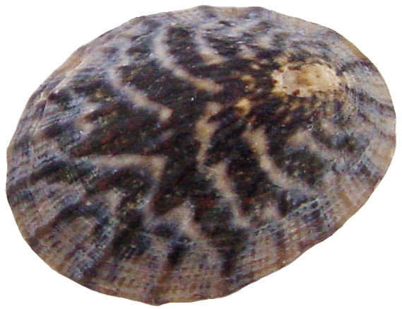
Seaweed
Red algae
Brown algae
Green algae

Slide 5
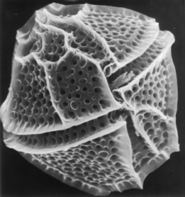
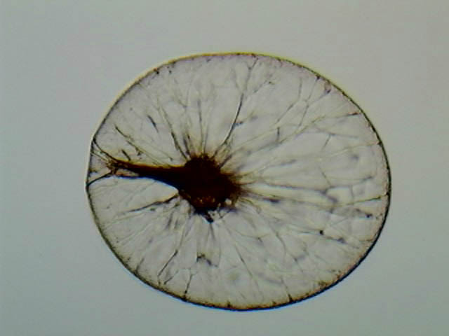
Microalgae
diatoms
dinoflagellates

Slide 6
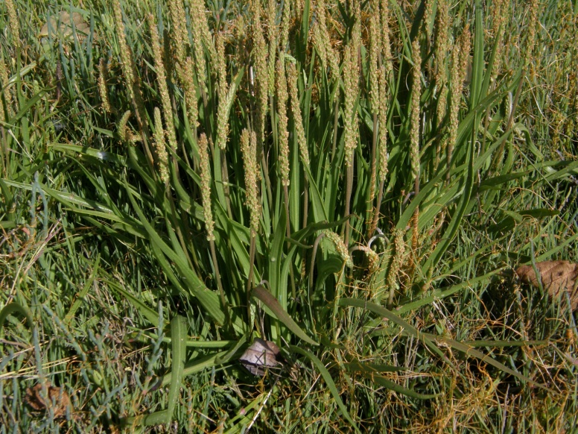
Vascular Plants
Seagrass
Marsh vegetation

Slide 7
Seaweed & Seagrass Productivity
Color infrared
photos
seaweeds

Slide 8
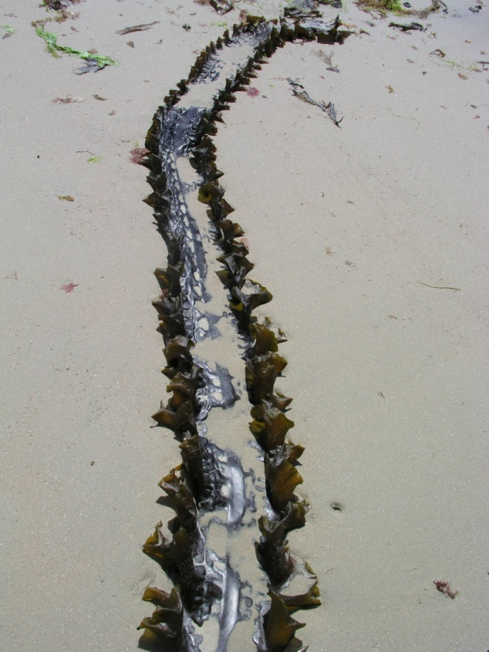
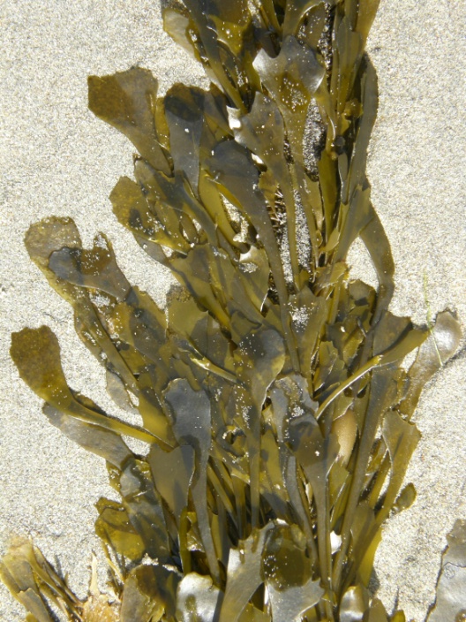
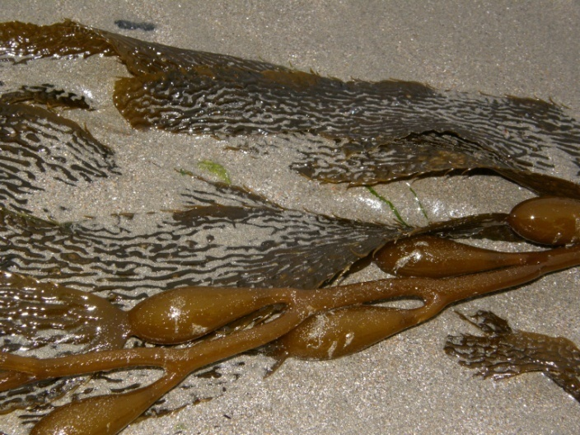
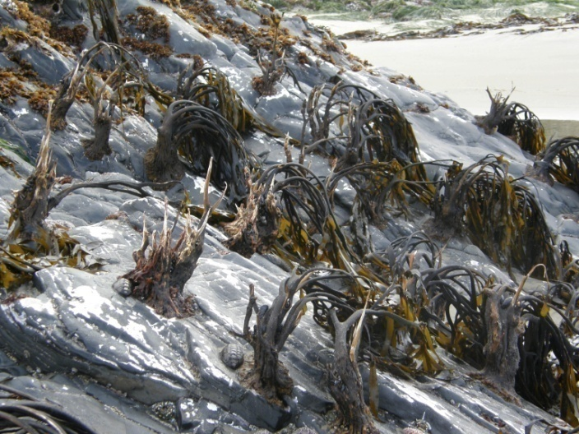
Productivity

Slide 9
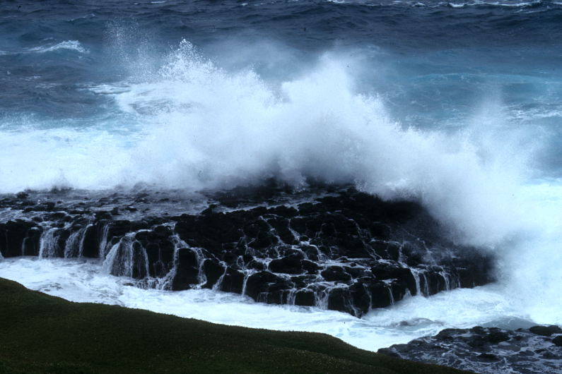
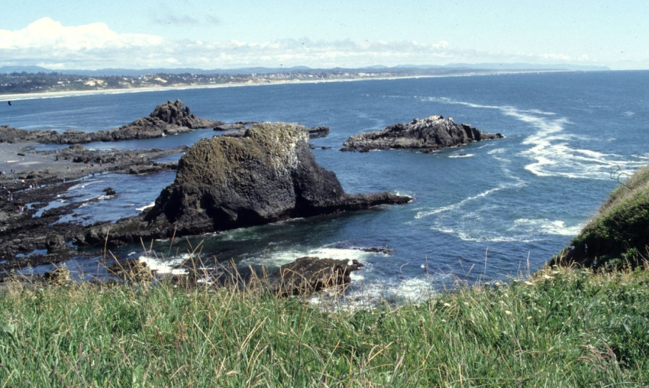
Invertebrate Biodiversity
~28 phyla in marine habitats
vs.
~6 in terrestrial habitats

Slide 10
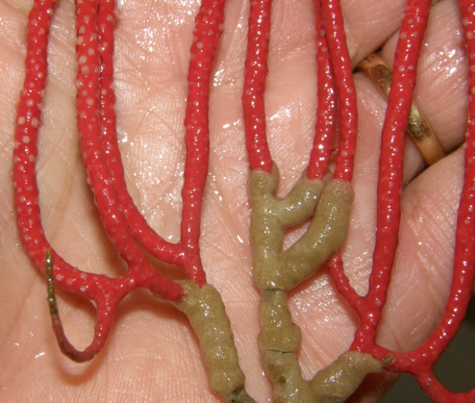
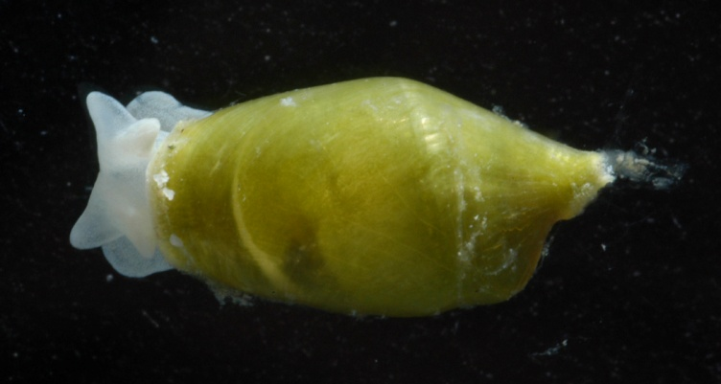
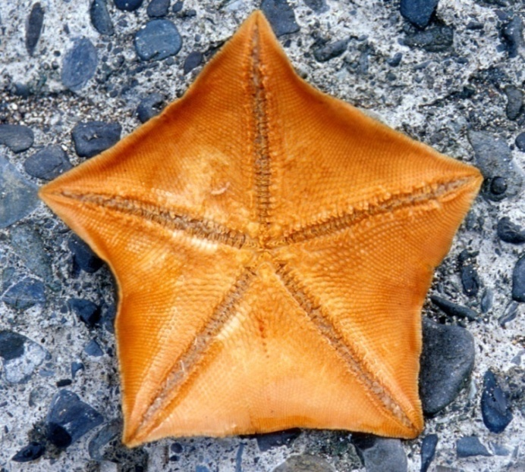
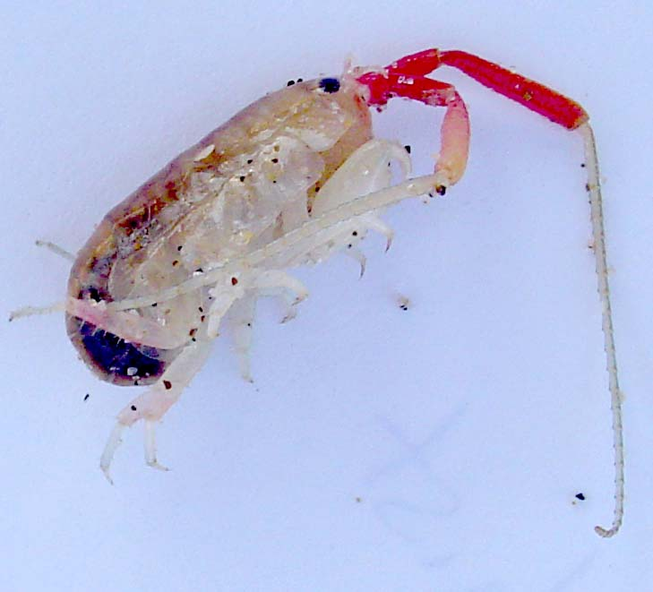
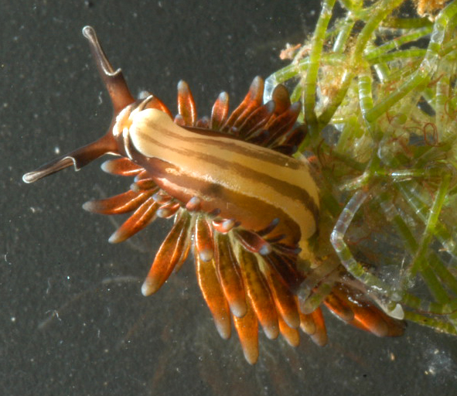
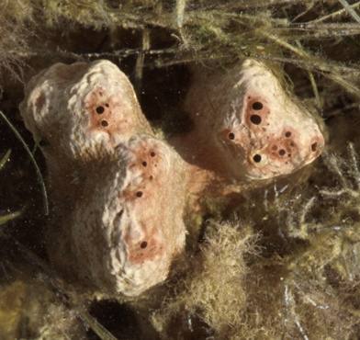
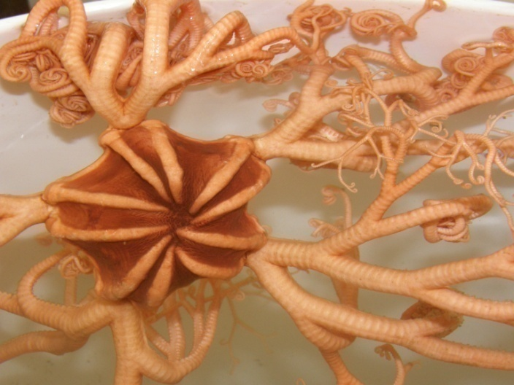
Invertebrates

Slide 11
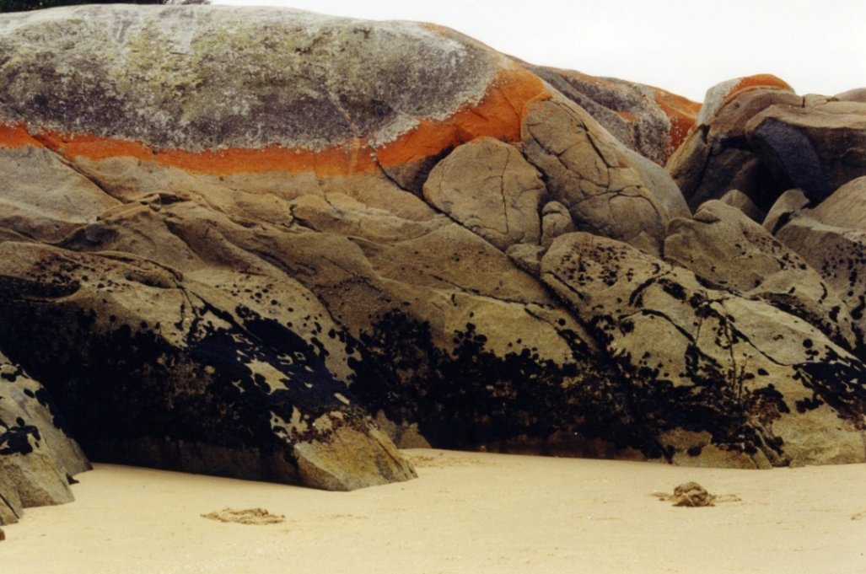
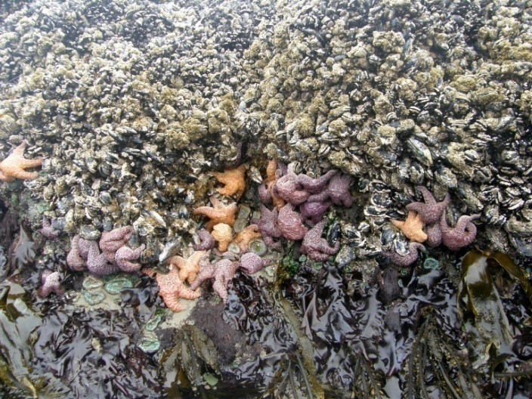
Major Factors Rise & fall of tides Wave action

Slide 12
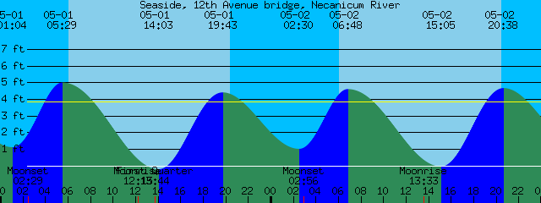
Tidal Patterns

Slide 13
Tidal Predictions
http://tbone.biol.sc.edu/tide/index.html
Government or local tide tables

Slide 14
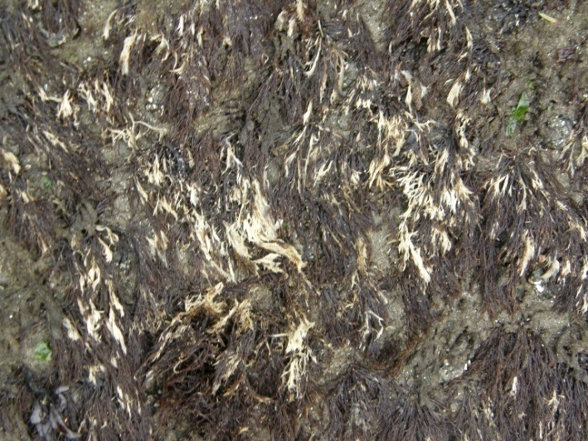
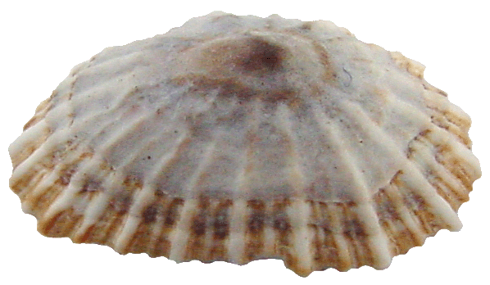
Tidal Effects

Slide 15
Vertical Zonation
Horizontal bands or zones of species
Zones arrayed perpendicular to a physical gradient
Not unique to seashore

Slide 16
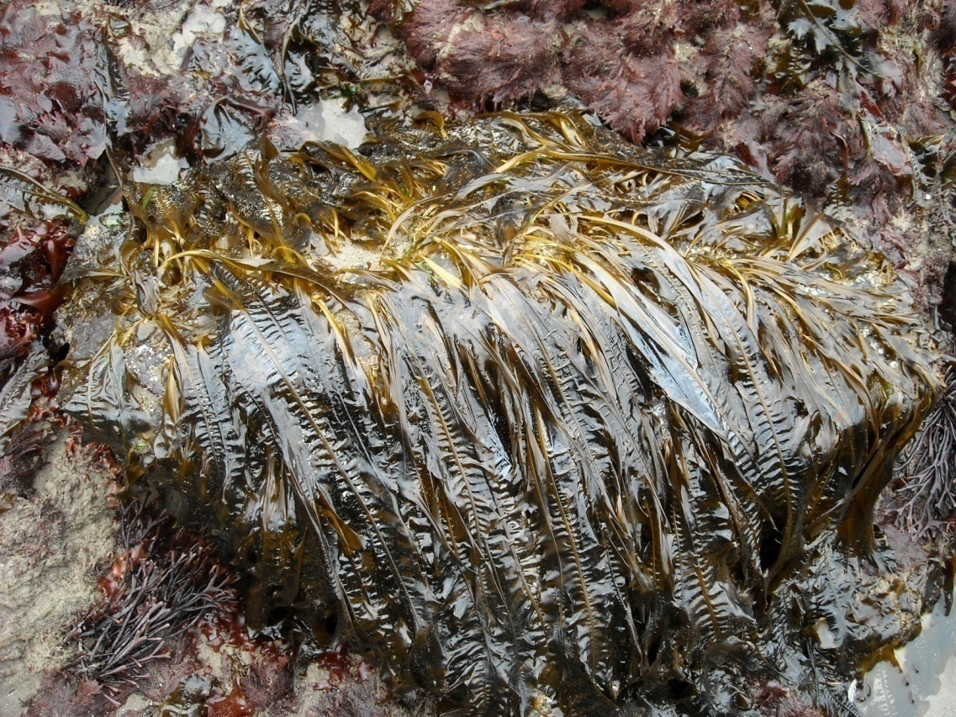
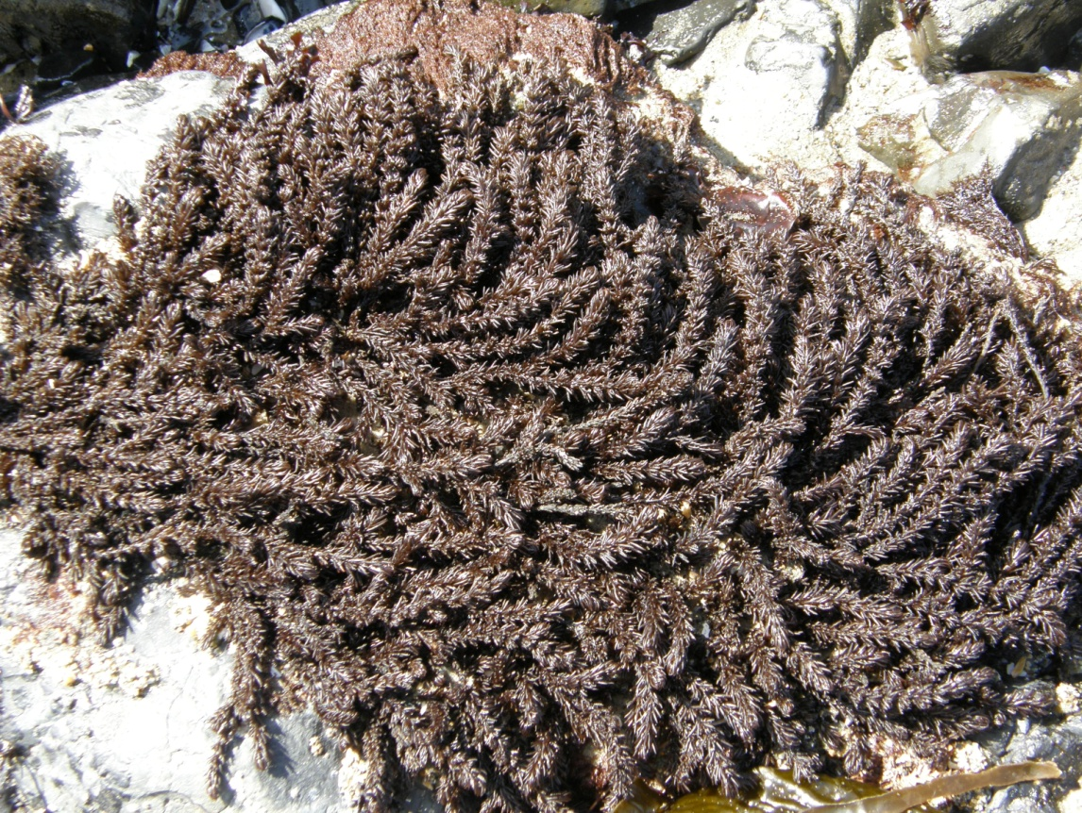
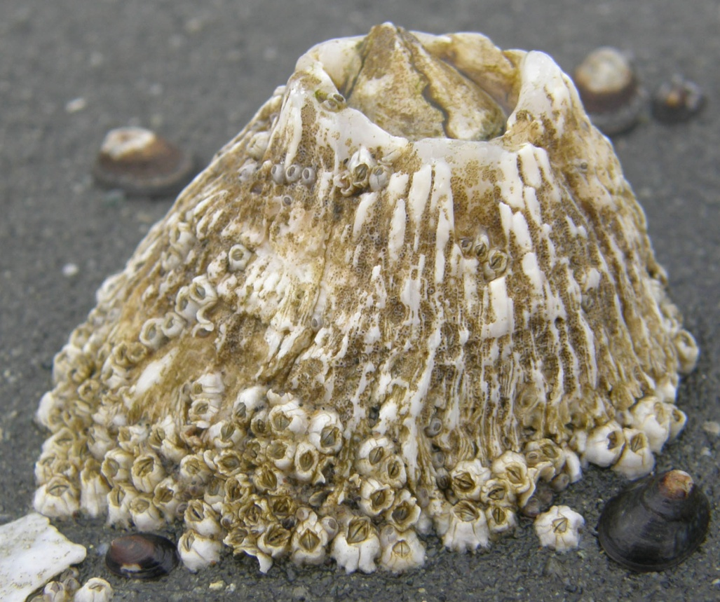
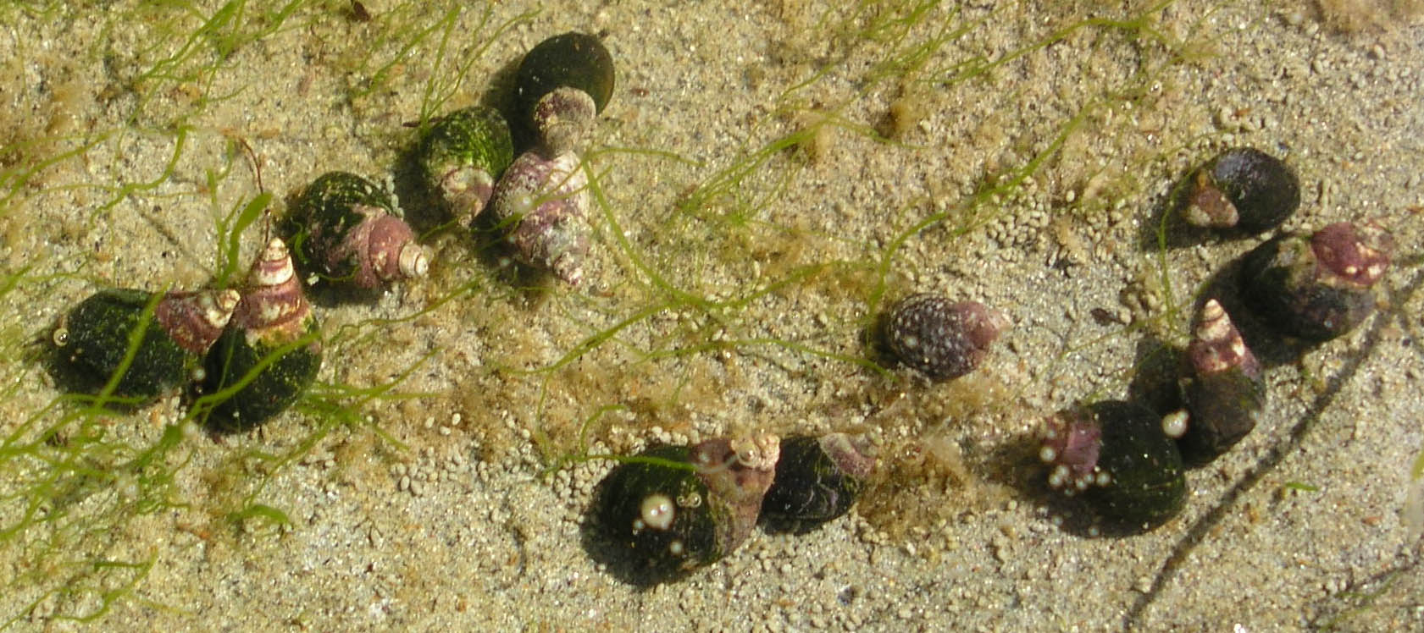
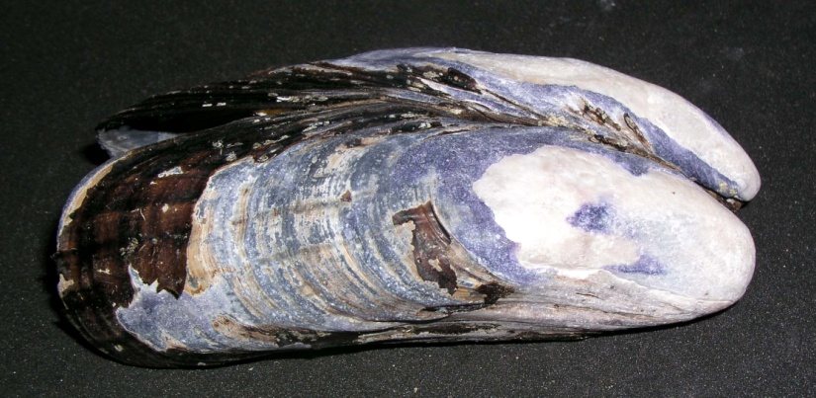
Generalized Zonation Pattern
blue-green “algae”, lichen, and small snails
barnacle & fucoid zone
mussel zone
red algal zone
kelp zone
high
low

Slide 17
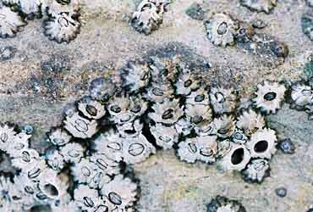
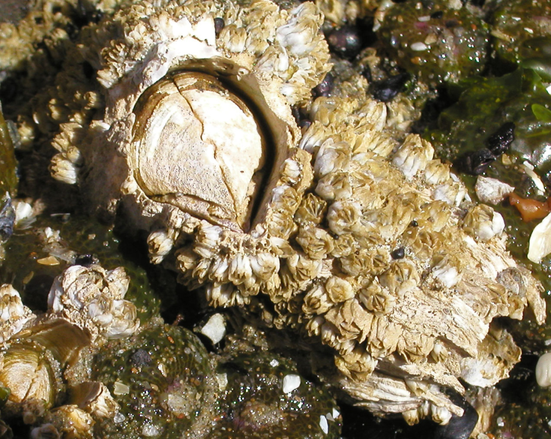
Acorn Barnacles
Cyprid larva
Chthamalus
Balanus
Semibalanus

Slide 18
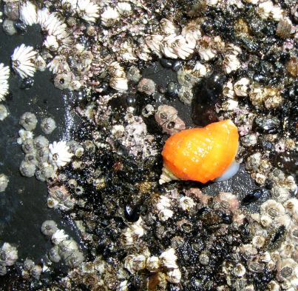
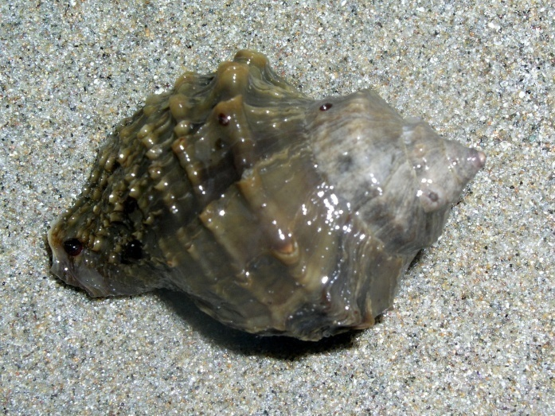
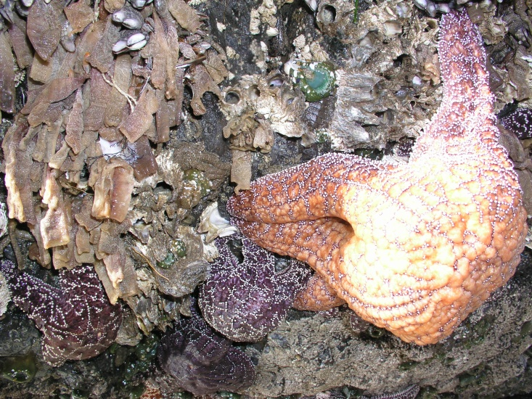
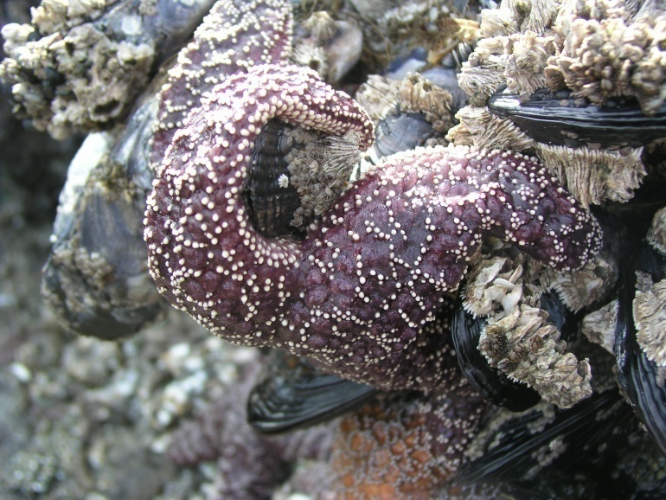
Major Predators
Nucella
Pisaster

Slide 19
Tides & Wave Action Influence:
Predation
Herbivory (Grazing)

Slide 20
Tides & Wave Action Influence: Competition

Slide 21
Oswald West State Park

Slide 22
Short Sands Beach
Sand-influenced rocky shore

Slide 23
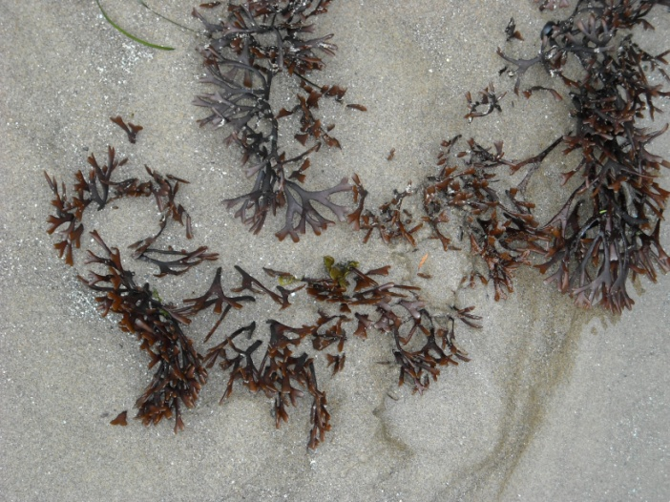
Sand-Influenced Rocky Shores
Sand smothers & kills many mobile consumers
Few sea urchins
Few large snails
Few sea stars
Sand smothers & kills many seaweeds
Ephemeral species
Resistant species

Slide 24
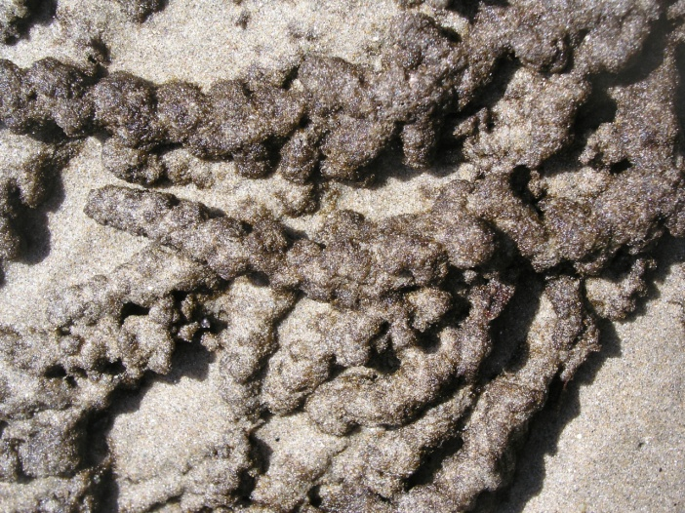
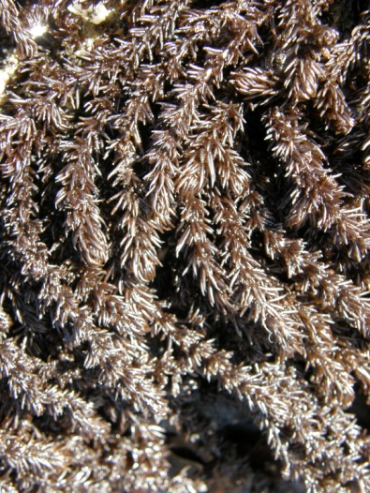
Diatoms

Slide 25
High Plankton Productivity
Sessile invertebrates

Slide 26
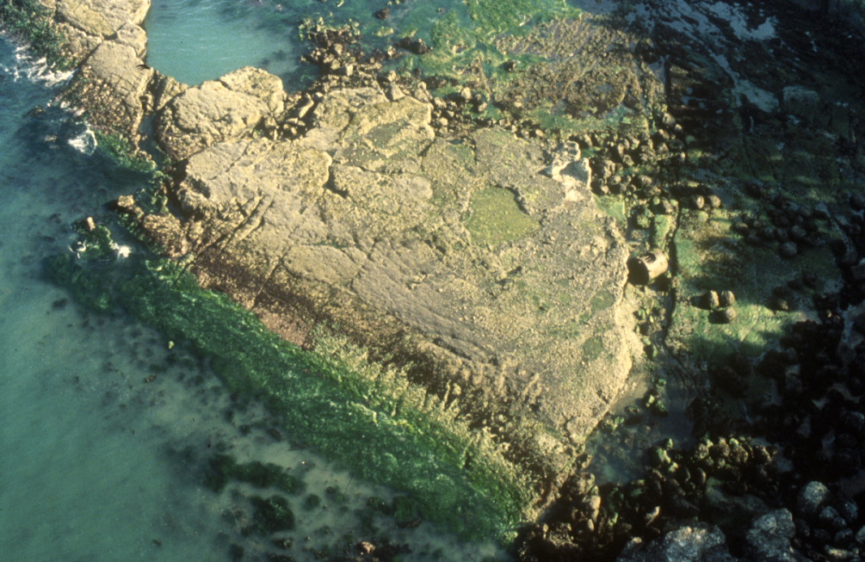
Patterns
Zonation patterns
Rise & fall of tides
Wave action
Consumers
Competitors
Sand disturbance
Highly productive waters

